Slide 1


Card Transactions in eCommerce
Pankaj Tade
Anil Panda 23 July, 2025
© 2025 Global Payments Inc. All rights reserved.

Slide 2
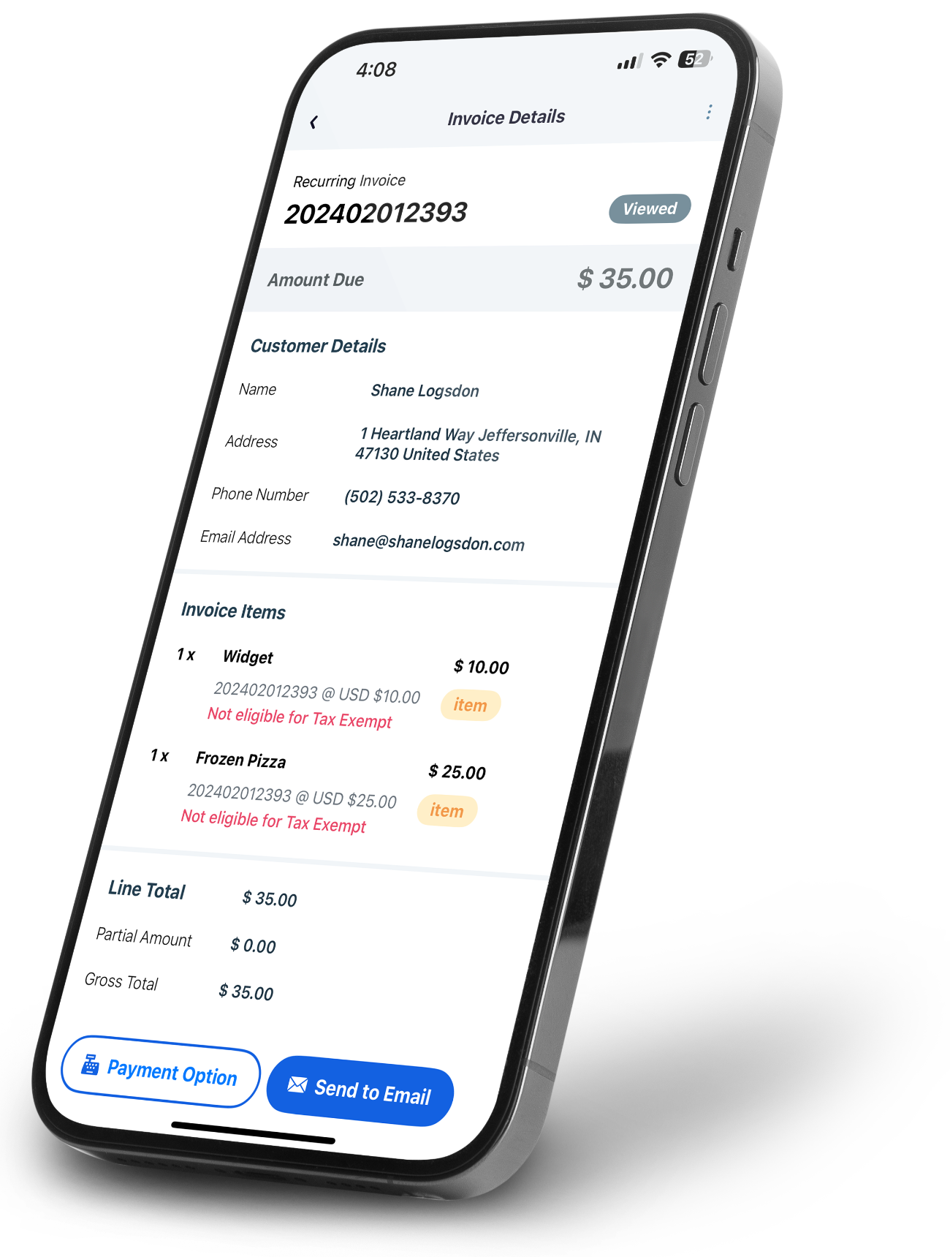
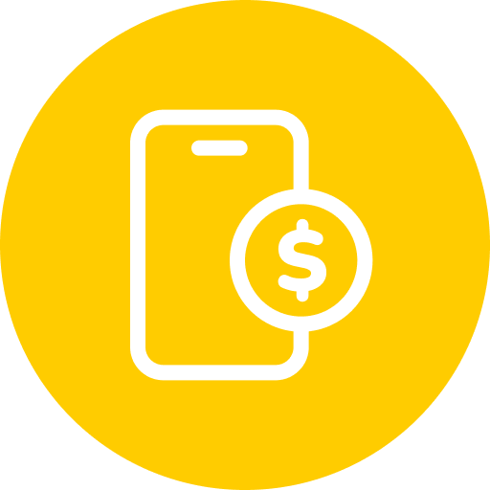
Agenda
01
eCommerce Transactions
02
Security and Compliance
03
Trends and Innovation
04
MOTO Transactions
05
Questions
© 2025 Global Payments Inc. All rights reserved.
‹#›

Slide 3
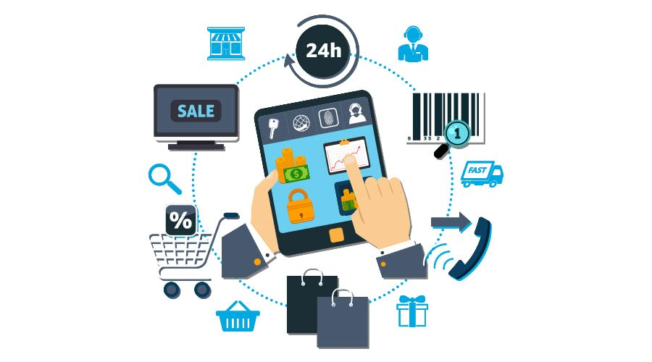

eCommerce
e-commerce, or electronic commerce, refers to the buying and selling of goods or services over the internet.
e Commerce Transactions are Card-Not-Present (CNP) Transactions
Credit, Debit and Prepaid cards are amongst the most popular card payment methods globally
Auth, Rebate and Settlement are the most popular transactions
Payment
processed

Slide 4
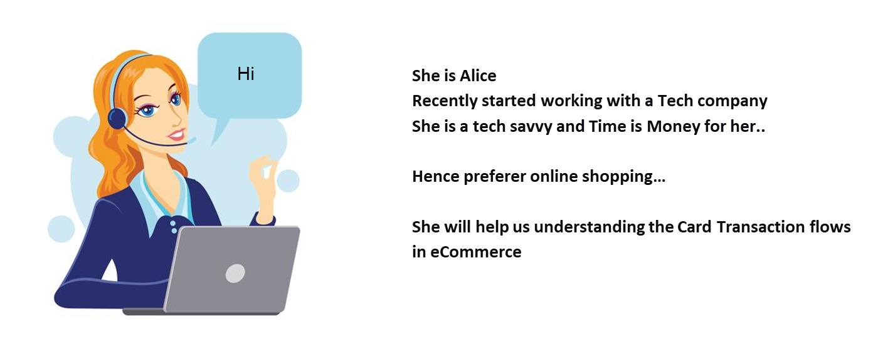

Slide 5
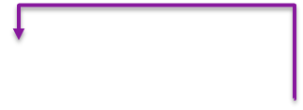




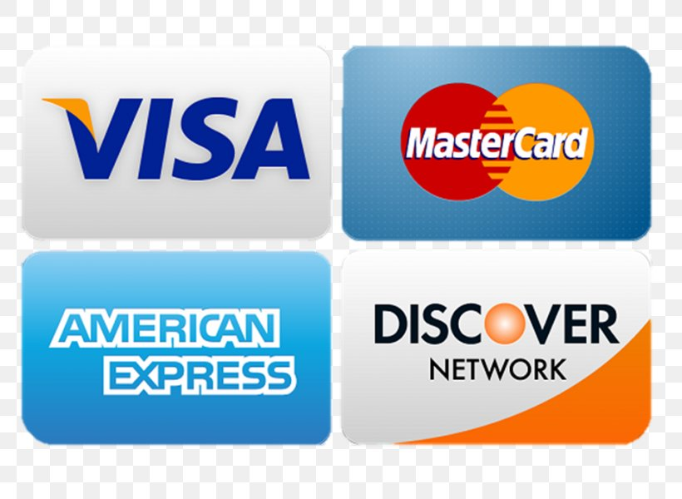
eCommerce Transactions
Batch
13.Settlement Batch File
11. Deliver Product
12.All Auth processed for a day
1.Card details
2.Auth
3.Auth
14.Settlement Batch File
10.Success/ Failure
9.Auth Response
8.Auth Response
Customer
Merchant
Payment
Gateway
Acquirer
4.Auth
7.Auth Response
6. Auth Response
5.Auth
16. Monthly Bill
Issuer
Schemes
15.Settlement Batch File

Slide 6

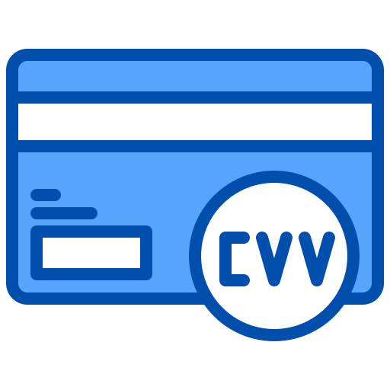
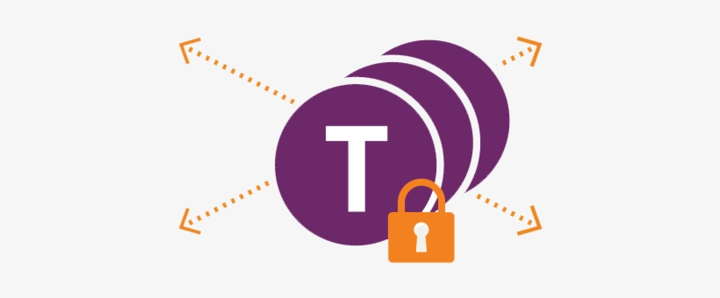


Security and Compliance
3DSecure2
CVV & AVS Check
PCI DSS
Tokenization
2 Factor Authentication Layer e.g. Additional layer of authentication to make sure that user performed the transaction with OTP, Biometric etc.
Adds layer of Fraud Prevention e.g. CVV validates Physical possession of the card. AVS matches Billing address provided with actual Billing address.
PCI DSS aims to protect cardholder data (like card numbers, expiration dates, etc.) from unauthorized access, fraud, and data breaches.
Replaces card number with Tokens e.g. Based on level of tokenization used, Card numbers are replaced in transaction with tokens.
© 2025 Global Payments Inc. All rights reserved.
‹#›

Slide 7




3DS2 – Frictionless Flow
3DS Requester environment
1.Auth
3DS
Requestor
12.Auth Response
3DS Server
Customer
Merchant
3.AReq
2.AReq
6.Auth
11.Auth Response
4.ARes
5.ARes
8.Auth
7.Auth
9.Auth Response
10.Auth Response
Payment
Gateway
Schemes
Issuer Domain
Interoperability Domain
Acquirer Domain

Slide 8
3DS2 – Challenge Flow
3DS Requester environment
1.Auth
6.Creq
3DS
Requestor
19.Auth Response
3DS Server
Customer
Merchant
3.AReq
2.AReq
4.ARes with Challenge ind
5.ARes with challenge ind
13.Auth
7.Cres
8.Cres
9.Cres
18.Auth Response
9.Rreq
10.Rreq
12.Rres
11.Rres
15.Auth
14.Auth
16.Auth Response
17.Auth Response
Payment
Gateway
Schemes
Issuer Domain
Interoperability Domain
Acquirer Domain

Slide 9
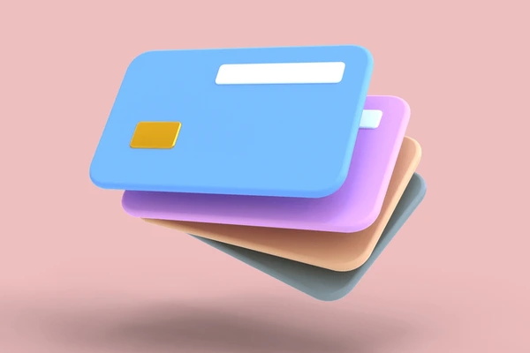
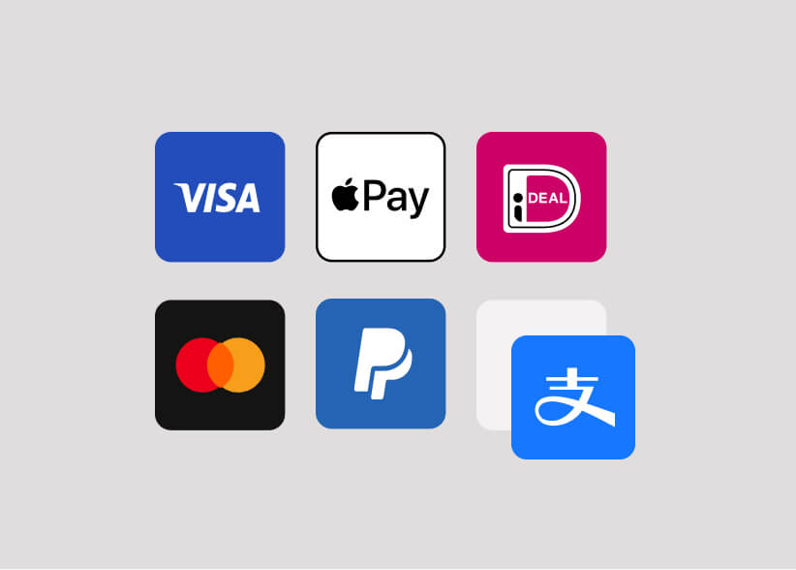
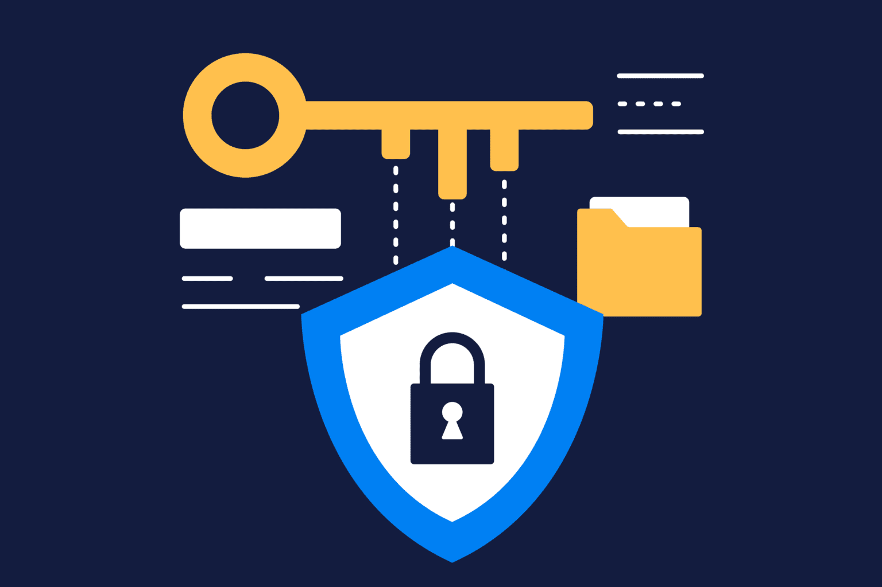
Trends and Innovation
Card on File (COF)
It refers to the practice where a merchant stores a customer's credit card information for future transactions, with the customer's prior consent.
Alternate Payment Methods
APMs in a payment gateway refer to any payment method besides traditional cash or major credit/debit cards. These methods offer more flexibility and convenience for customers and can be integrated into a payment gateway to offer a wider range of options to users.
Tokenization
Payment tokenization replaces sensitive card information with a unique, random token. This token acts as a substitute for the actual card details during transactions, enhancing security by preventing the storage or transmission of sensitive data.
Footer notes here

Slide 10

COF – 1st Transaction
Card Storage Service
10.Token
9.Card Details
1. Card Details
2.Card Details
3.Card Details
12.Token
11.Token
8. Success
Customer
Merchant
Payment
Gateway
Acquirer
4.Card Details
7. Success
6. Success
5.Card Details
Issuer
Schemes

Slide 11
COF – Next Transaction
Card Storage Service
4.Card Details
3.Token
1. Token
2.Token
5.Card Details
12.Success
11.Success
10. Success
Customer
Merchant
Payment
Gateway
Acquirer
6.Card Details
9.Success
8 Success
7.Card Details
Issuer
Schemes

Slide 12
Network Tokenization
1. Token
2.Token
3. Token
12.Success
11.Success with Token
10. Success
with Token
Customer
Merchant
Payment
Gateway
Acquirer
4 Token
9.Success
with Token
8 Success card
5.Token
7.Card Details
6.Card Details
Card Storage Service
Issuer
Schemes

Slide 13
PCI Tokenization
1. Token
2.Token
3. Token
4.Token
12.Success
11.Success with Token
10. Success
with Token
5.Card Details
Customer
Merchant
Payment
Gateway
Acquirer
Card Storage Service
6.Card details
9.Success
card
8 Success card
7.Card Details
Issuer
Schemes

Slide 14
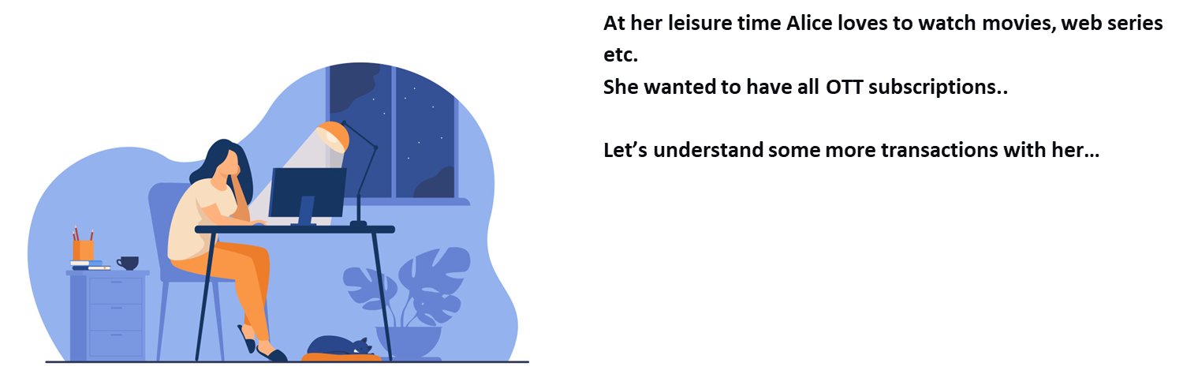

Slide 15

Customer Initiated Transaction (CIT)
Card Storage Service
10.Token
9.Card Details
1.Card Details
2.Card Details
3.Auth
12.Success
11.Token + Auth Res
8.Auth Res
Customer
Merchant
Payment
Gateway
Acquirer
4.Auth
7.Auth Res
6.Auth Res
5.Auth
Issuer
Schemes

Slide 16
Merchant Initiated Transaction (MIT)
Card Storage Service
2.Token
3.Card Details
1.Token
4.Auth
11.Receipt
10.Auth Res
9.Auth Res
Customer
Merchant
Payment
Gateway
Acquirer
8.Auth Res
5.Auth
7.Auth Res
6.Auth
Issuer
Schemes

Slide 17



MOTO – Mail Order Telephone Order
Key Characteristics:
Card-Not-Present:
MOTO transactions are classified as card-not-present (CNP) transactions, meaning the physical card and the cardholder are not present at the point of sale.
Remote Payment:
Customers provide their payment information to the merchant through mail, email, or phone.
Manual Entry:
The merchant manually enters the card details into a payment system.
Authorization:
The customer authorizes the transaction by providing their card details, and the merchant then processes the payment on their behalf.

Slide 18

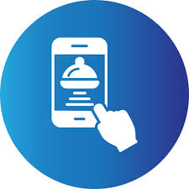
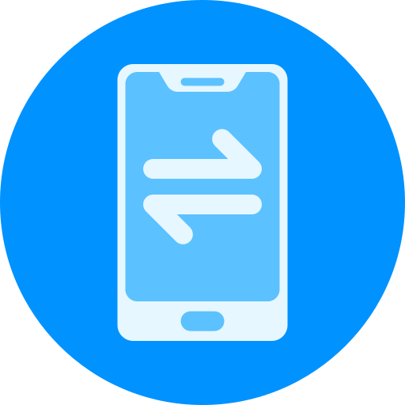

MOTO Transaction – How it Works
Customer Initiates Order
Merchant Enters Order
Payment is Processed
Order is Fulfilled
The customer places an order by phone or mail and provides their payment information.
The merchant enters the customer's card details (card number, expiry date, etc.) into a payment terminal or virtual terminal.
The payment is processed, and the merchant receives confirmation.
The merchant fulfills the order based on the payment confirmation.
Footer notes here

Slide 19

Security trends in MOTO Transactions
01
02
IVR
Pay by Link
For phone orders, businesses might use an interactive voice response (IVR) system that prompts the customer to enter their card details using the phone keypad.
The merchant send link on the Customers mobile to make a payment using payment page.
Footer notes here

Slide 20


Questions
Footer notes here

Slide 21
Thank you

